Slide 1


Introduction to Presentation skills Technical Writing and Presentation
TRƯỜNG ĐẠI HỌC BÁCH KHOA HÀ NỘI
HANOI UNIVERSITY OF SCIENCE AND TECHNOLOGY
SoICT - 2020

Slide 2
The aims of the lesson
Training skill of talking to an audience
Contents involved in public speaking
Understanding what influences the audience?
Ability to speak clearly, concisely and convincingly
Developing both personal confidence and skills to take into your future career
Notes:
whether you decide to become a student representative or just want to make a contribution at a society meeting.

Slide 3
The importance of presentation skill
We all need to do this in on an everyday basis
It is an integral part from most subjects at school, work, and life
Efficiency in performing a task
Increase motivation
Using simple explanation and allocating a small amount of time
Notes:
People will perform better if they understand the importance and need of the task
5/you may resolve many issues that might come up

Slide 4
Presentation skill in the 21st century
People are exposed to vast volumes of information
You need to maximize your message in a minimized amount of time.
Example – On a televised interview, the interviewee has an uninterrupted amount of time of between 2 -3 minutes.
Can you get your point across in such a short amount of time?
Remember, the audience has a choice, they don’t have to sit and listen to you !

Slide 5
Choice of words in presentation
Depends upon
the meaning we want to convey,
the person receiving the message and
the situation in which the communication takes place
Examples
Words for a pleasant feeling of general goodwill: cheerfulness, jollity, merriment, pleasure, joy, happiness.
Use appropriate words
merriment vs joy
Are conditioned both by the person who is going to hear them and the situation in which we find ourselves.
Talking to a friend: can be informal, even careless about our words
Speaking to a prospective employer: must be formal and careful.
Notes:
merriment might last only for a moment or two at the end of a joke, while joy suggests a much deeper and more lasting emotion

Slide 6
Speaking is an art
Think carefully about:
Do the audiences really want to listen?
Do they know how to interpret our tone of voice and our body language?
Are they preoccupied with their own thoughts?
Is their knowledge of the language we’re speaking good enough for our purposes?

Slide 7
10 tips for Presentation
Practice, practice, practice
Speak, don’t read
Be yourself
Aim for a positive state of mind and a confident attitude
Use verbal signposting
Use examples, illustrations and humor
Ask questions and invite participation
Be aware of eye contact and body language
Learn from the Pros
Be aware of technique

Slide 8
Contents
Introduction to Presentation skills
Non-verbal Communication
Voice, Silence, Body language
Model digital introduction

Slide 9
I. Introduction to Presentation skills
Structuring your story
Preparing your data/information
Preparing and giving the presentation
Concluding your presentation
Questions and answers

Slide 10
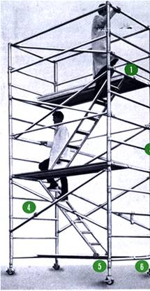
How to Give an Effective Presentation: Structure
Basic rule
Say what you are going to say
1-3 main points in the introduction
Say it
Give the talk
Then say what you said
Summarize main points in the conclusion
Don’t try to build suspense and then unveil a surprise ending

Slide 11

Tell a Story
Prepare your material so that it tells a story logically
Subject: title, authors, acknowledgements
Introduction/overview
Method/approach
Results/information/analysis
Conclusion/summary
Use examples, anecdotes, and significant details
Create continuity so that your slides flow smoothly
Guide the audience through your story
Your last point on one slide can anticipate the next slide

Slide 12
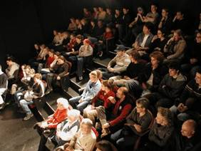
Audience
Why and to whom are you giving this presentation?
What do you want the audience to learn?
Think about this as you construct your talk
Edit your slides -- delete what is unnecessary, distracting, confusing, off point

Slide 13
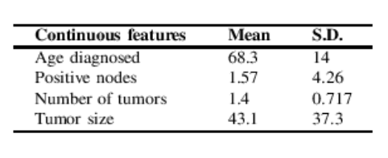
Presenting Your Methods, Data, and Results
Methods, Instrumentation
For most talks, only present the minimum
Data Tables
Tables are useful for a small amount of data
Include units
Indicate data source if they are not your own

Slide 14
Preparing Your Data (continue)
Figures
‘1 figure ≈ 1000 words’
Figures should be readable, understandable, uncluttered
Keep figures simple, use color logically for clarification
Blue = cold, red = warm, dark = little, bright = a lot
Invisible color
Meaning attached to colors (color blindness is more common than you think
Explain axes and variables
Include reference on figure

Slide 15
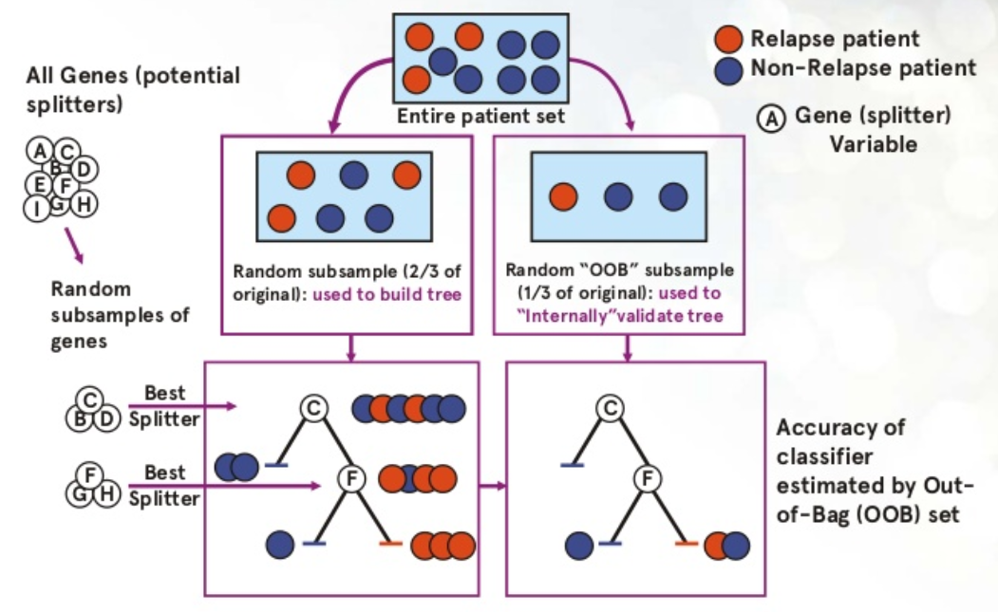
Problem: Classìication. An algorithm tries to predict the label for a sample.
Sample: feature data (gene expression level for a patient + label
Label : What category (basal, luminal) the sample falls in
The Machine Learning algorithm takes many samples to a training set and builds an internal model
ML algorithm predicts labels of other sample called testing set.

Slide 16

Figures continued ...
Create a summary cartoon with major findings, or an illustration of the processes or problem
Consider showing it at the beginning and the end
You can use web sources for figures
Include reference

Slide 17
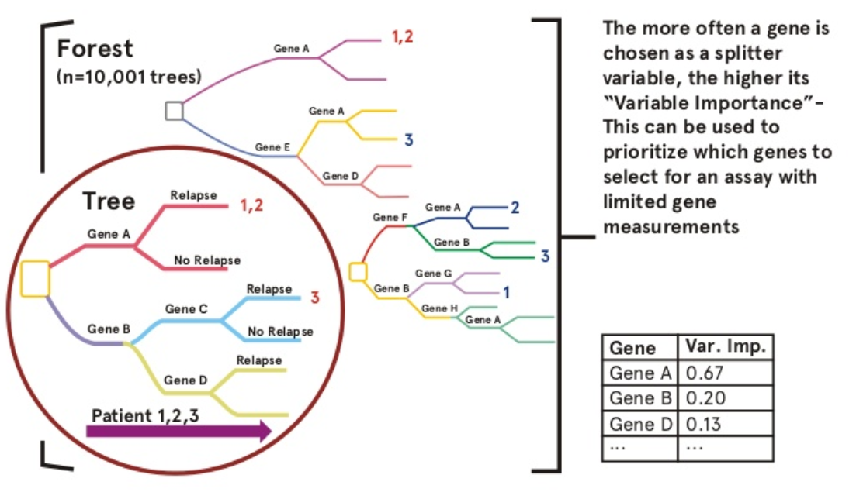
Variable importance-feature of Random Forest
Notes:
Trong các bài toán phân lớp dữ liệu thì Random Forest (RF) được sử rất dụng phổ biến dù có tuổi đời rất trẻ (được phát minh bởi Ho năm 1995). RF là một thành viên trong họ thuật toán Decision Tree, tư tưởng chính của RF là xây dựng nhiều cây quyết định từ dataset, mỗi cây quyết định dự đoán một kết quả và kết quả nào được nhiều cây quyết định dự đoán thì đó là kết quả cuối cùng. Để chắc chắn rằng không phải tất cả các cây quyết định đều cho cùng câu trả lời (nếu như các cây quyết định được xây dựng theo cùng 1 cách thì chúng sẽ cho cùng một câu trả lời), trong quá trình xây dựng cây, RF chọn ngẫu nhiên các quan sát (observations) quá trình này gọi là bootstrapping và chọn ngẫu nhiên các thuộc tính quá trình này gọi là attribute sampling. Random Forest được đánh giá cao bởi tính chính xác của mô hình. Nhược điểm chính của Random Forest khối lượng tính toán lớn, tuy nhiên với năng lực tính toán ngày càng tăng của máy tính (theo cấp lũy thừa) thì hạn chế của Random Forest không phải là vấn đề lớn.

Slide 18
Preparing the Presentation
Average not more than 1 slide per minute
MS Powerpoint is now standard
If you use something else, be careful to check it in advance
No sounds! Some logical animations good
Use 3-7 bullets per page
Avoid writing out, and especially reading, long and complete sentences on slides because it is really boring to the audience
Slide appearance (font, colors) should be consistent
Spell check

Slide 19
What Font to Use
Type size should be 18 points or larger:
18 point
20 point
24 point
28 point
36 point
AVOID USING ALL CAPITAL LETTERS BECAUSE IT’S MUCH HARDER TO READ
* References can be in 12-14 point font

Slide 20
Color
Dark letters against a light background work
Dark letters against a light background
are best for smaller rooms, especially when the lights are on for teaching
http://www.fw.msu.edu/orgs/gso/documents/GSOWorkshopDocsSp2006/PresentationTipsinPowerPoint.ppt#302,5,Powerpoint basics: 1. What font to use

Slide 21
Color
Light letters against a dark background
also work
Many experts feel that a dark blue or black background works best for talks in a large room
http://www.fw.msu.edu/orgs/gso/documents/GSOWorkshopDocsSp2006/PresentationTipsinPowerPoint.ppt#302,5,Powerpoint basics: 1. What font to use

Slide 22
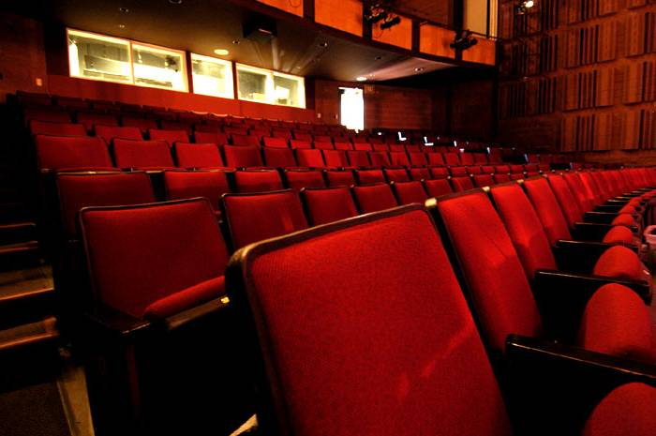
Preparing Yourself...
Immerse yourself in what you are going to say
Web of Science/Google it: use the latest news
Make sure you are familiar with the projection equipment, remote control and Powerpoint
Bring your presentation on a memory stick AND a laptop with power supply AND an extension cord …

Slide 23
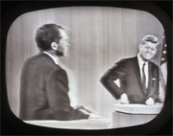

What to Wear …
Dress up – maybe wear a jacket?
More formal attire makes you appear more authoritative and you show you care enough to try to look nice
From “Ask Dr. Marty” AnimalLabNews (Jan-Feb 2007)
Dark clothes are more powerful than light clothes
Shirts or blouses with collars are better than collarless ones
Clothes with pressed creases (!) are signs of power

Slide 24
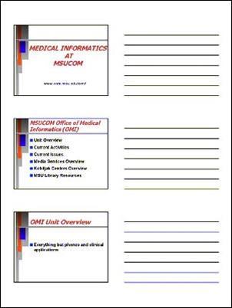
Print Your Slides
Don’t read the presentation
Print out copies of your slides (‘handouts’)
You can annotate them and use them as notes
You can review them as you’re waiting
If everything crashes – the bulb blows, you can still make your main points in a logical way

Slide 25

Rehearsing
Practice – actually stand up and say the words out loud
You discover what you don’t understand
You develop a natural flow
You come up with better phrasings and ways to describe things
It is harder to explain things than you think, practicing helps you find the words
Stay within the time limit
Try speaking too loud to get a feeling where the upper limit is
Don’t over rehearse or memorize the talk
The first practice things will improve at least 10 fold -- the second will make things twice as good -- the third may add a bit of polish, but from there it can easily get worse

Slide 26

Giving the Presentation
Starting out is the hardest part of the talk
To get going, memorize the first few lines
“Hello, I’m Huong Nguyen. The title of my presentation is, ‘Machine Learning for cancer’ .I want to combine computer science and biology.Machine learning techniques have been exploited as an aim to model or to simulate the progression and treatment of cancerous condition.”

Slide 27
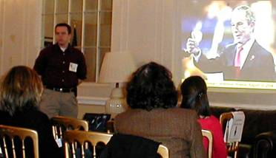
Giving the Presentation
Experienced speakers:
Speak freely and look directly at audience
Inexperienced speakers:
Put outline and key points of your presentation on your slides
You don’t have to remember what to say
Eyes are on the slide not on you
Key points are there for people who weren’t listening or who are visual learners

Slide 28
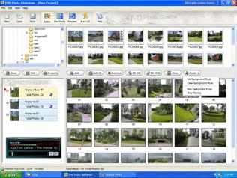
Giving the Presentation
Stand where the figures can be seen
Look at people during presentation
Be enthusiastic
Don’t worry about stopping to think
Don’t rush
Figure out which slide is your half-way mark and use that to check your time

Slide 29
Giving the Presentation
Don’t apologize or make comments about yourself
“I hope you’re not bored”
“I was working on this ‘til 3 am”
Don’t overuse the pointer
Don’t try to be cute and don’t force being funny
Don’t forget acknowledgements, always give proper credit
Tip: Everyone in the audience has come to listen to your lecture with the secret hope of hearing their work mentioned

Slide 30

Concluding Your Content
Announce the ending so that people are prepared
For example, with a slide titled “Conclusions”
Or by saying, “In my final slide …” or “My final point is …”
Have only a few concluding statements
Come back to the big picture and summarize the significance of your work in that context
Extend logically beyond your limited study – but don’t overreach
Open up new perspective
Describe future work, raise questions, potential implications

Slide 31
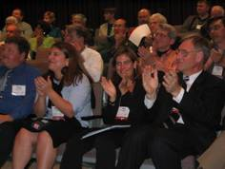
Finishing Your Presentation
Think carefully about your final words and how to finish your presentation strongly
Don’t just drift off … “I guess that’s all I have to say …”
You may want to actually memorize your ending lines, just as you do your starting points
Ending your talk
Say “Thank You” … pause for applause … then
Say: “Any questions?”

Slide 32

What Can Go Wrong?
Uncertainty about material
Interruptions
Running out of slides
Running out of time

Slide 33
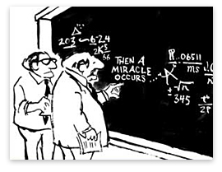
Uncertainty About the Material
Try to structure your talk so that you are sure about the material you present
If you have to address something important that you are unsure of
Acknowledge the gap in your understanding
“I’m working on it” or “I’m looking into it”
This is better than being pressed to admit something
Also it may very well be an open question
Another way to handle this is to raise it as a question yourself

Slide 34

Minor Interruptions during Your Presentation
Don’t look irritated or rushed
Answer – briefly – just enough to straighten it out
Then carry on with your presentation without checking back
A question that you will answer later in your talk?
Say “Good point; just wait two slides”
Requires a long answer and is not critical understanding?
Say “Good point; I’ll come back to it at the end of the talk.”

Slide 35

Major Interruptions During Your Presentation
If most in the audience are non-specialists
Explain the issue to the audience
Delay discussion until after the talk
If most of the audience is knowledgeable
Make your point as clearly as you can
Discuss it out – don’t try to diminish or avoid it

Slide 36
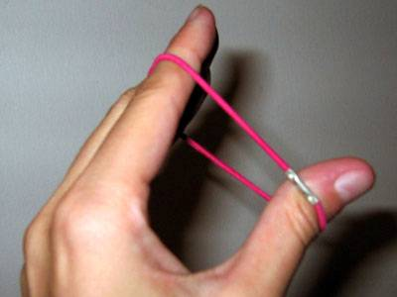
Running Out of Slides
Short talks are better than ones that are too long
What to do:
Don’t make a personal comment
“hum, I’m running out of slides …”
Stretch it a little -- see if you can think of an example, or story, to bolster your points
Conclude unhurriedly, summarizing your main points, but don’t be repetitious

Slide 37
Running Out of Time
Avoid this – impolite to other speakers and the audience: if it happens …
Do not assume that you can carry on past your time
Do not skip all of your slides looking for the right one to put on next
Conclude – on time wherever you are in your talk -- by making your main points
In Powerpoint you can just type the number of your concluding slide and press Enter to skip right to it

Slide 38

Questions and Answers
Questions after your talk can be difficult but they definitely help you in writing up your research
Identifies parts the audience did not understand
Focuses and adds dimension to your analysis
You can repeat the question
This gives you time to think
The rest of the audience may not have heard the question
Also if you heard the question incorrectly, it presents an opportunity for clarification

Slide 39
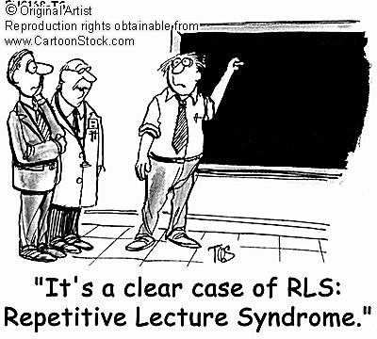
Questions and Answers (continued)
Keep your answers short and to the point – don’t respond with another lecture
Don’t say that a question is bad, or that you addressed it already
Rephrase it into something that you want to talk about
Never demean the question or questioner
They may have friends in the audience, and you never need more enemies
The research world is smaller than you think and you will continue to encounter people throughout your career

Slide 40

Difficult Questions
Usually you have thought more about the material than anyone else -- this puts you in a stronger position than you may think
Anticipate typical questions and prepare for them
Generalizability of your findings to other times? Other places? Other conditions?
Methodological bias? Uncertainties? Exceptions? Priorities?
Still concerned about questions?
Make extra slides – perhaps on details of instrumentation or methodology

Slide 41
Difficult Questions (continued)
If you really don't know the answer
Say "Interesting, I will look into that" or “That’s a good point, let’s discuss it afterwards”
Don't feel that you have to invent an answer on the fly -- you are only human and you can't have thought of everything
If the questioner disagrees with you and it looks like there will be an argument then defuse the situation
"We clearly don't agree on this point, let's go on to other questions and you and I can talk about this later"

Slide 42
Deal with difficulties
Taking the high road and thinking long term
If your host or the session chair handles something badly, don’t refer to it in public
If other panelists take too long – don’t complain, just make your main points within the remaining time
If something happens to make you angry, think of a way to turn it around rather than having a public confrontation,
Notes:
you gain more by being seen as rolling with the situation than you do by articulating your rights
Perhaps go up to them afterwards and talk with them – it could even lead to a collaboration

Slide 43
Conclusions
Structure your content in a way that is comfortable for you
Use your own style to your advantage
Think ahead about where you might encounter difficulties and figure out ways to overcome them

